Slide 1
Employee attrition

Slide 2
TEAM MEMBERS
K.GAGAN SAI
Y.DINESH KUMAR
Y. SAMPATH
V.ADITHYA SHARMA
Team - 7

Slide 3
EMPLOYEE ATTRITION
Reduction in the number of employees through retirement, voluntary/ involuntary resignation or death is called “Attrition”.
Attrition is also called total turn over or wasteage rate.

Slide 4
TYPE OF ATTRITION
GOOD ATTRITION:
Less productivity employee leaving.
BAD ATTRITION:
-High performance leaving.
MARKET DRIVEN ATTRITION:
-Influenced by market changes.
WORKLOAD/STRESS ATTRITION:
-Low band-width of employee.

Slide 5



The factors on which the Employee Attrition depends upon are:
Better pay.
Long work timing.
Health/Age problems.

Slide 6


Cont….
Lack of growth of opportunities.
Uncooperative team members.
Over expectations from the work place.

Slide 7
Formulating an approach
To solve this problem ,I decided to use a three combinaton analytics:
Descriptive Analytics:- What are the observation that helps us to shape our various hypotheses about staff attrition?
Predictive Analytics:- Which members of staff are about to leave.
Prescriptive Analytics:- What insight or suggestions can be made concerning those members of staff who are likely to leave?

Slide 8
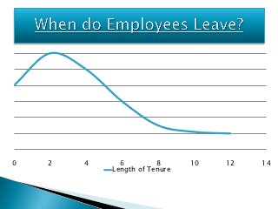
When do employee leave?

Slide 9
Large proportion of employees leave within two years of tenure.
Job shoppers:
-Early stage of career.
-Urgency to get more salary in less time.
-trail and error.

Slide 10
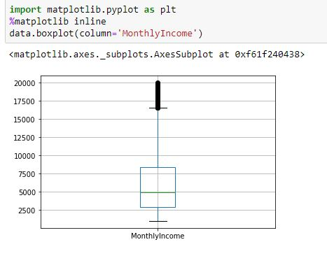
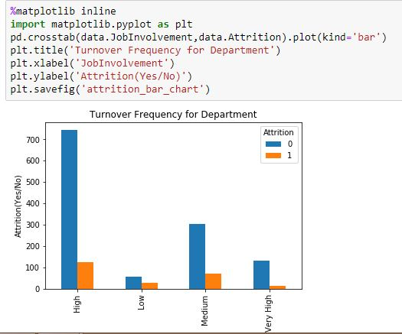
Plots and graphs

Slide 11
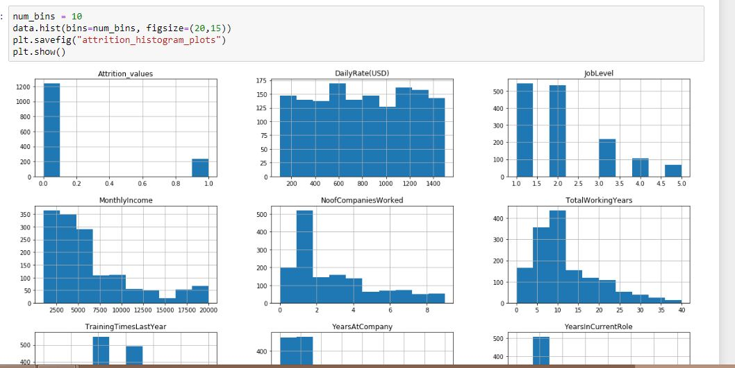
SCATTER PLOT:

Slide 12
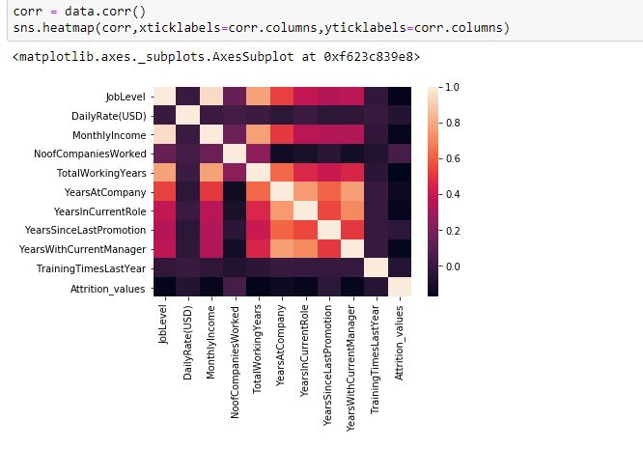
Heat map

Slide 13
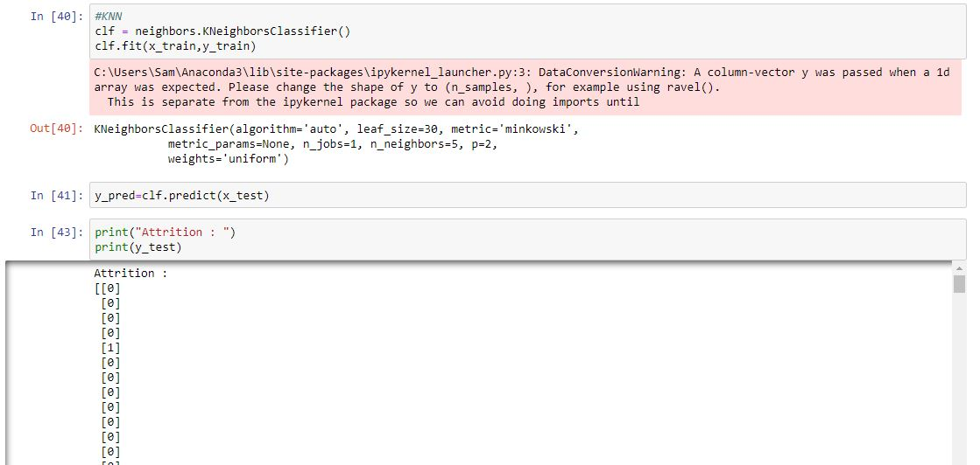
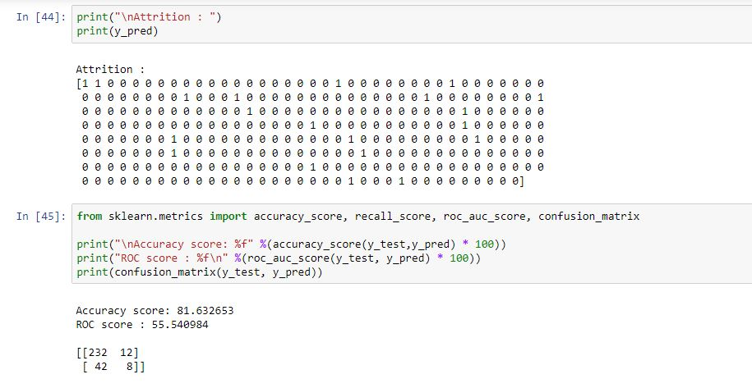
KNN

Slide 14
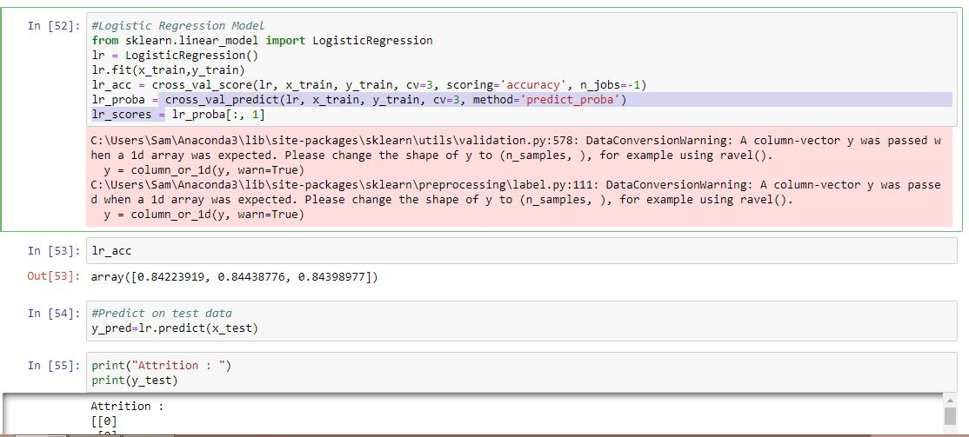
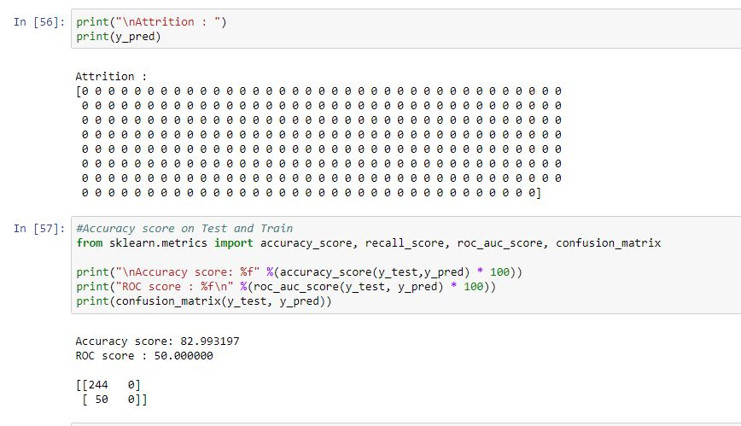
LOGISTIC REGRESSION

Slide 15
CONCLUSION
So, here we conclude that 80% testing and 20% training for the KNN model and LOGISTIC REGRESSION, as it has 81.63% accuracy and 82.99% accuracy respectively.

Slide 16

THANK YOU
Team - 7

